Slide 1




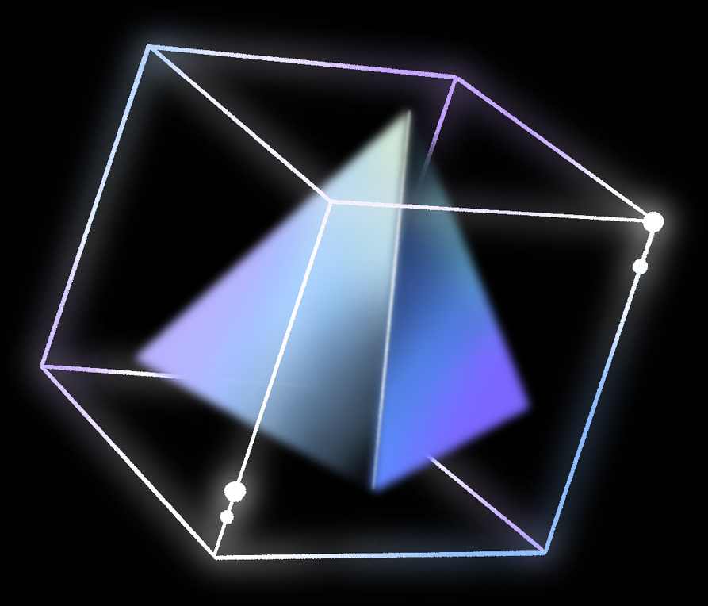
Python Turtle Basics
Byeolah Kwon
Friday August 2, 2024

Slide 2
Class Topics
How to use Turtle in Python
How commands work in Python
Movement Commands
Other Commands

Slide 3
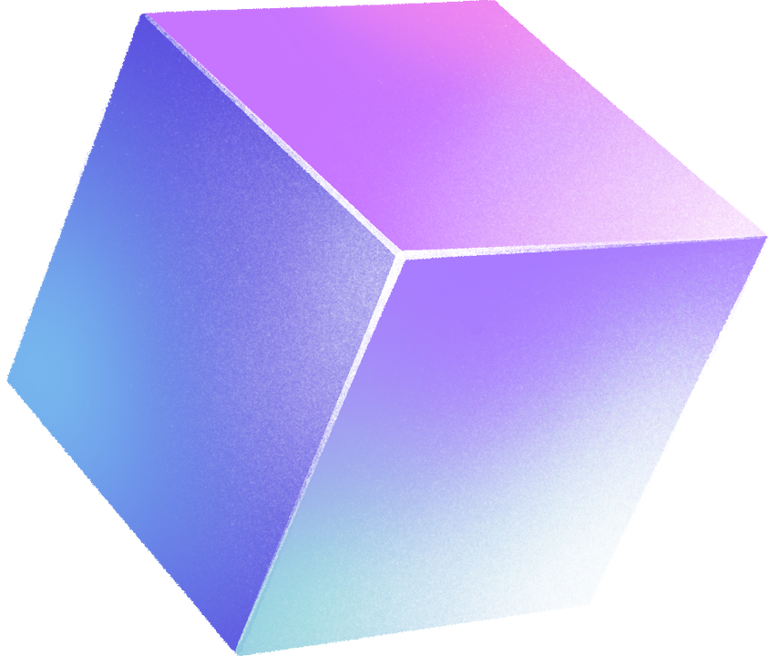
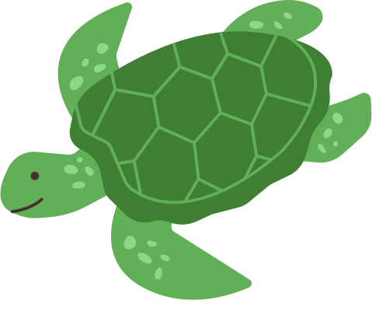
What is Turtle?
How to use Turtle in Python?
Turtle is a Python library that allows programmers to create pictures and shapes
Repl.it is a tool to work with Python Turtle

Slide 4
Import the turtle library
and initialize the turtle
First, you will type this code: import turtle
Next, you will assign a name to your turtle
The name should start with an English letter, and it can include numbers, underscores, or multiple words. However, it cannot have spcaes or special characters.

Slide 5

Name Formats Examples
Acceptable name formats | Unacceptable name formats
peter t coolturtle cool_turtle ninjaTurtle NINJATURTLE NinjaTurtle123 | 1peter peter bugman ninja turtle ninja*Turtle 1234 turtle

Slide 6
Special command to initialize
special command Turtle() with a capital T to activate the turtle
ninja_turtle = turtle.Turtle()
In this example, the assigned name to a turtle is ninja_turtle

Slide 7
Import the turtle library
and initialize the turtle
Let’s go to Repl.it and do this together!

Slide 8
Movement commands
forward() or fd()
ninja_turtle.forward(100)
100 is the distance I want my turtle to go forward by
100 pixels is about the size of your thumb
backward() or bk()
left() or lf()
right() or rt()

Slide 9

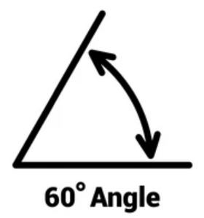
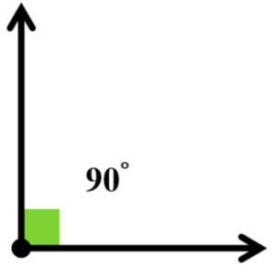
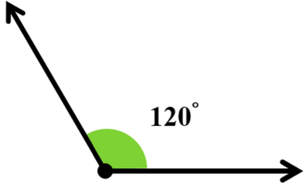
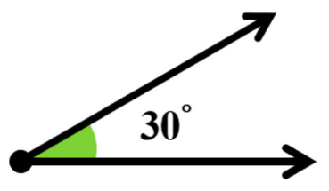
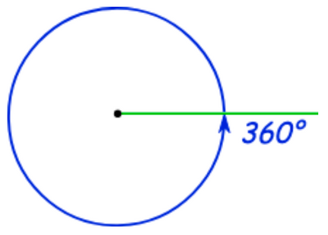
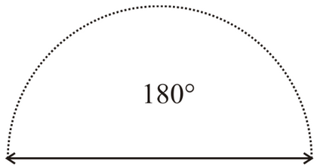
How to use the left and right commands
The left and right commands turn your turtle to a direction by an angle
30 degrees
acute angle
60 degrees
a bigger acute angle
90 degrees
a right triangle
120 degrees
an obtuse angle
180 degrees
a straight angle
360 degrees
a full angle

Slide 10
Let’s practice together on Repl.it
We will create a square by using the movement commands we learned

Slide 11
Other Commands
The color command
ninja_turtle.color(‘red’)
blue, green, red, cyan, magenta, yellow, pink, orange
The shape command
ninja_turtle.shape(‘turtle’)
arrow, turtle, circle, square, triangle, classic
Make sure you don’t forget the quotes around the shape name and the color name
The speed command
ninja_turtle.speed(10)
fastest: 0, fast: 10, normal: 6, slow: 3, slowest: 1

Slide 12
Let’s add more commands on Repl.it
We will customize our turtle
by using the color, shape, and speed commands we learned

Slide 13
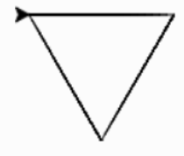
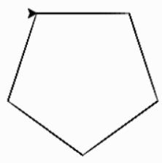
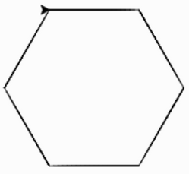
Now it’s time to practice by yourself!
You’ll create some shapes:
Triangle
Pentagon
Hexagon

